Slide 1
Recitation 6

Slide 2
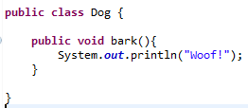
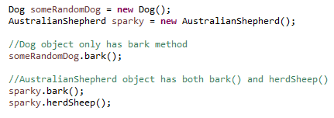
Inheritance
A way for a class to copy another class and build on it.
“superclass” or “base class”
“subclass” or “derived class”

Slide 3
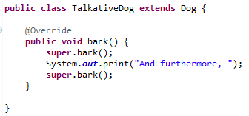
Overriding methods
You can also call your superclass methods, from any method inside the subclass:

Slide 4
Inheritance, cont.
Inheritance is a way to reuse code.
It is also a way to achieve polymorphism:

Slide 5
When should you use it?
Conceptually, inheritance is meant to be used in “is a” relationships. For example, because “Apple is a Fruit”, Apple can inherit from Fruit.
Putting it another way, Fruit is part of what makes an Apple an Apple.
Another good measure of whether you should use inheritance: can the derived class be used anywhere that you need the base class?
For example, if I have a function that needs a Fruit, an Apple works just as well (because “Apple is a Fruit”).
Practically, inheritance is used when you need to make a class that is a more specific case of a different class.
In this case, you probably need all the same code, with minor adjustments

Slide 6
How does it compare to interfaces?
Practically speaking:
Inheritance brings code with it, interfaces require you to write your own
You can only inherit from one class in Java, but implement many interfaces
However, both allow for polymorphism.
Conceptually speaking:
Interfaces help describe the role of a class instead of what it is
An Apple is a Fruit, but has the roles of Food, Juiceable, RoundThing, etc
Apple would inherit Fruit but implement the interfaces Food, Juiceable, etc.
It’s a fuzzy distinction
In general:
If you’re looking just for polymorphism, interfaces are a better idea.
Inheritance is used for code reuse, in cases where it is obvious that it is a good fit.

